Slide 1



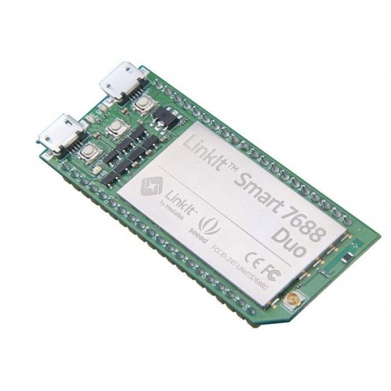
Indoor Object Positioner

Slide 2
Indoor Object Positioner

Slide 3
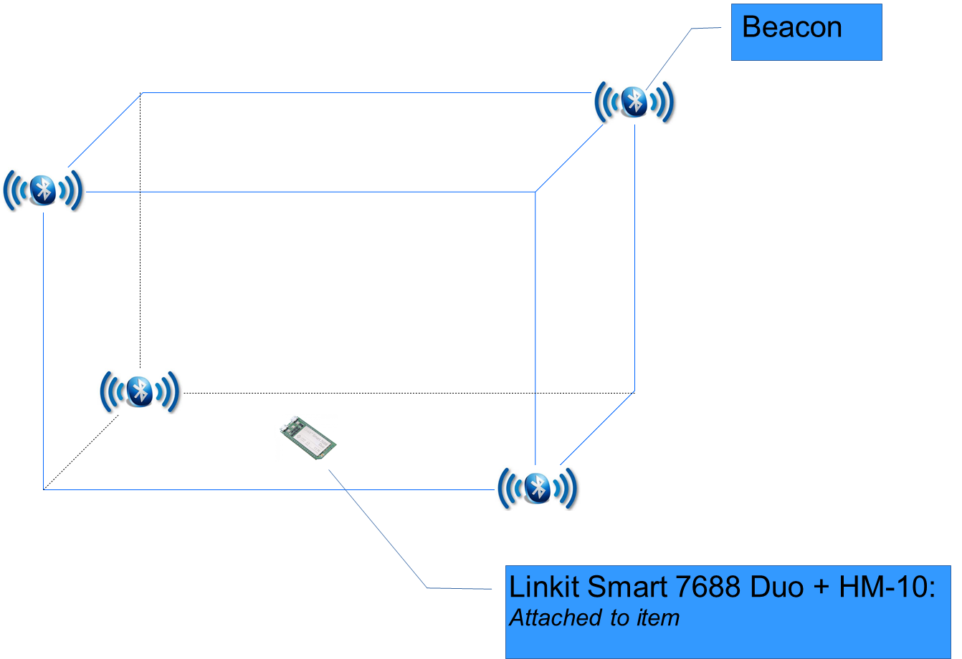
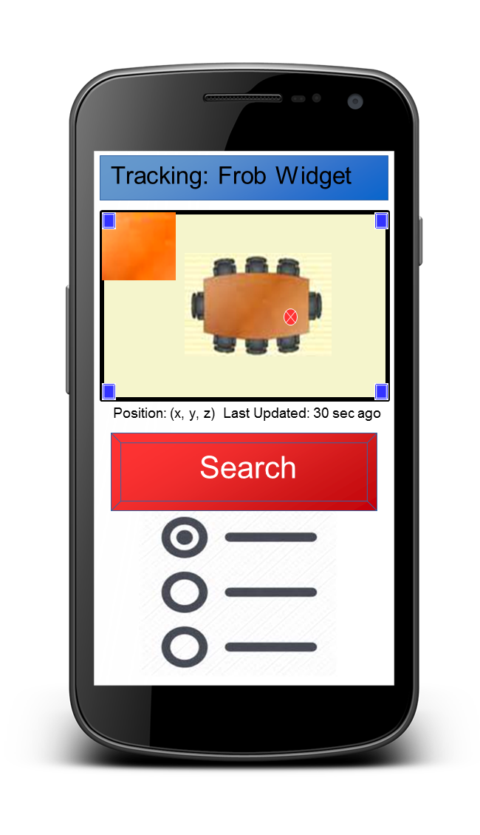


Upon getting the RSSI from the LinkIt, the Server filter the RSSI before spawning a Python shell
This shell finds the LinkIt’s approximated coordinates, stores it with a timestamp, and then plots it on a map.
Beacons are placed in set positions
HM-10 is set as a receiver and scans for Bluetooth signals
LinkIt reads Beacon RSSI via the ATmega
7688 gets the Bluetooth discovery from the ATmega, parses out the wanted values, and send it to the server
GETS map and data from server
Displays data upon request and show timer stating time since update
Can select which chip to display and also rename chips

Slide 4
Room Layout
Beacon
Linkit Smart 7688 Duo + HM-10:
Attached to item

Slide 5

Item Triangulation
WiFi
Bluetooth Signals

Slide 6


Positioning Algorithm

Slide 7
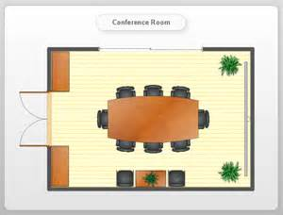
Server Mapping
Floor Plan

Slide 8


Application

Slide 9



App UI
Tracking: Frob Widget
Position: (x, y, z) Last Updated: 30 sec ago
Search

